Slide 1


Ping An Lottery

Slide 2

347 launched
697 hours
total 392 pages

Slide 3

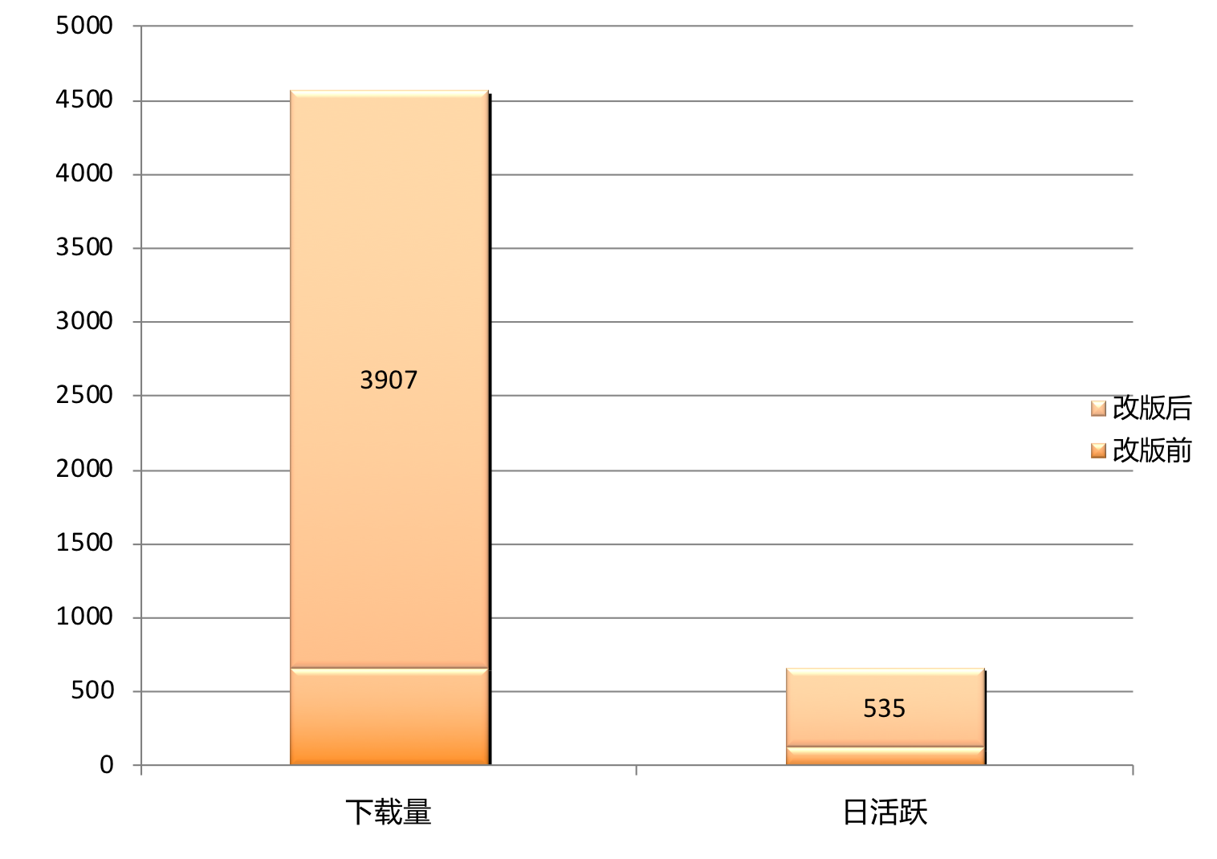
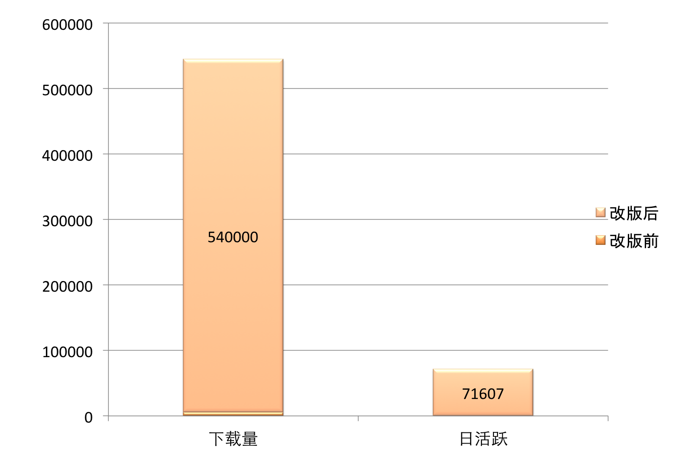
Android
iPhone
The average PV from Oct to Dec is 20973, after revision mobile and PC traffic ratio changed from 4:6 to 6:4

Slide 4
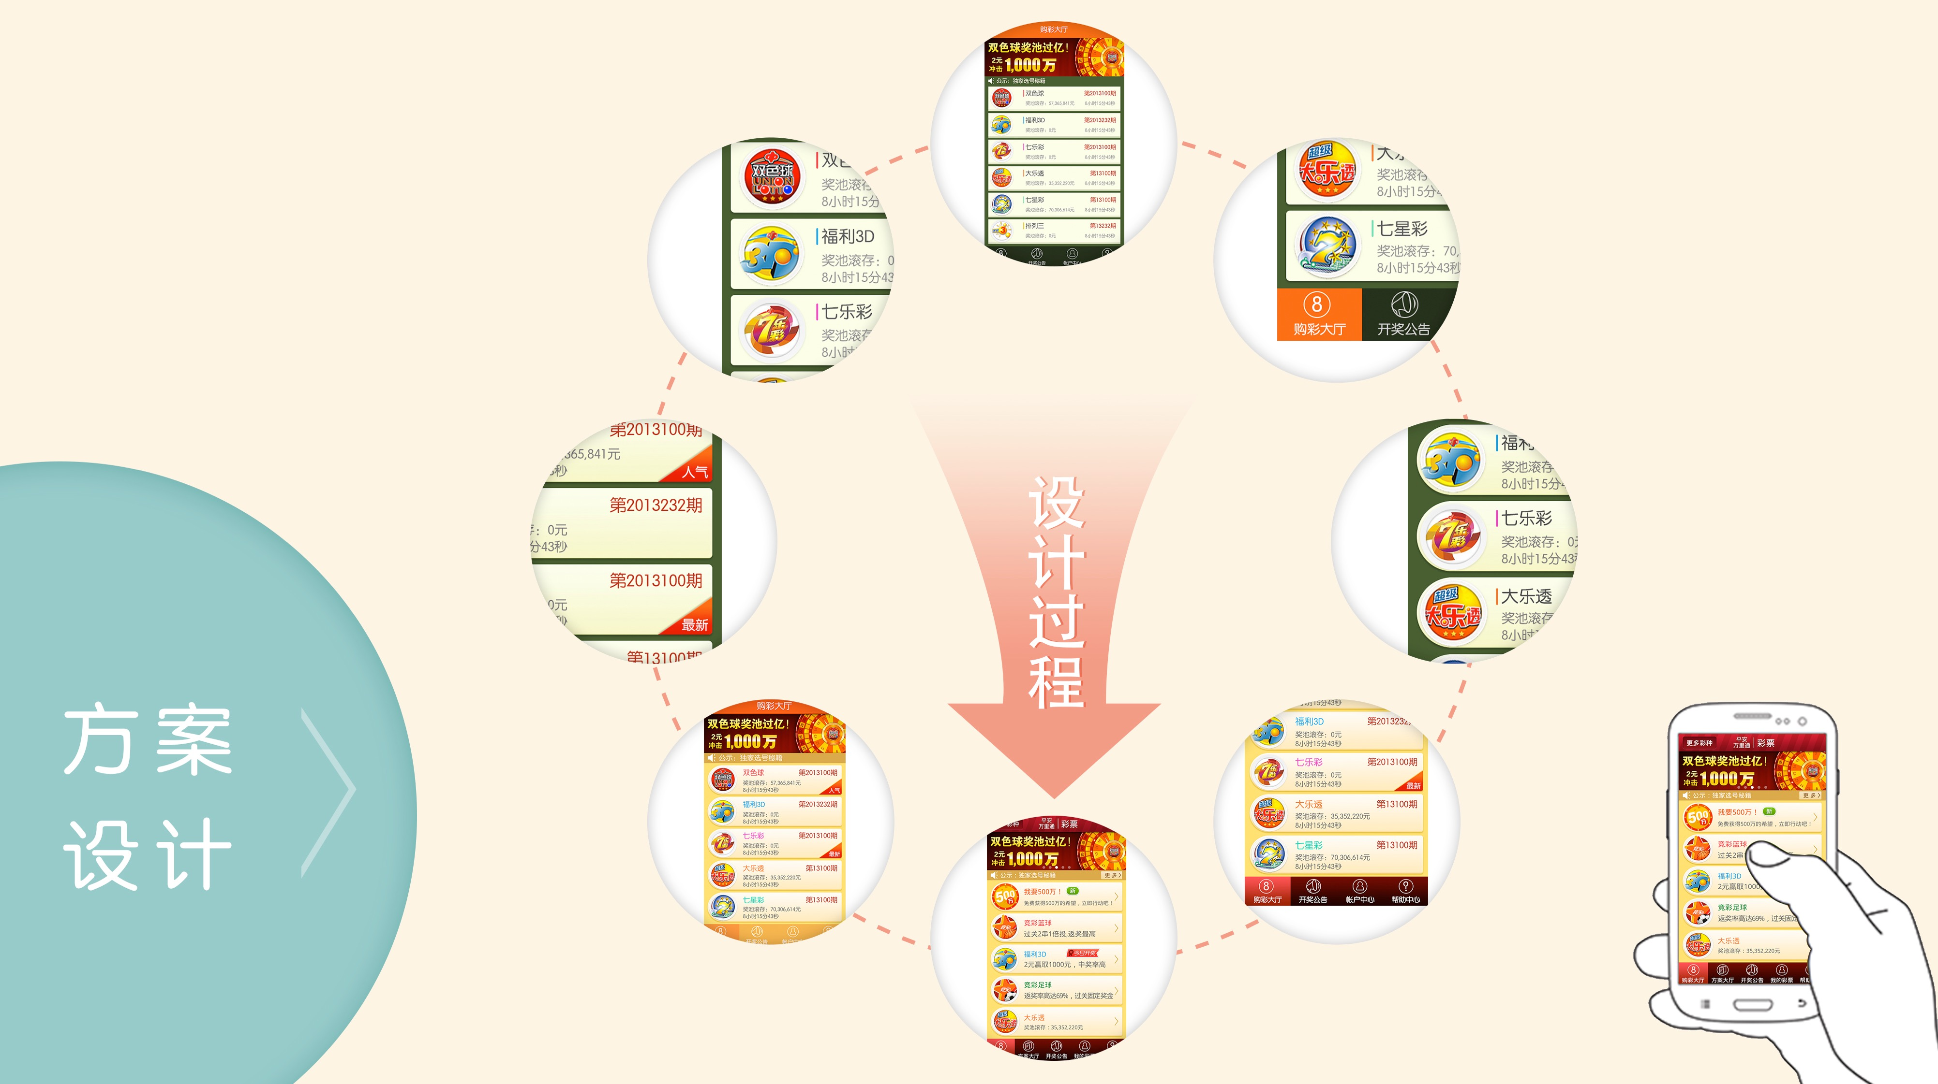

Slide 5
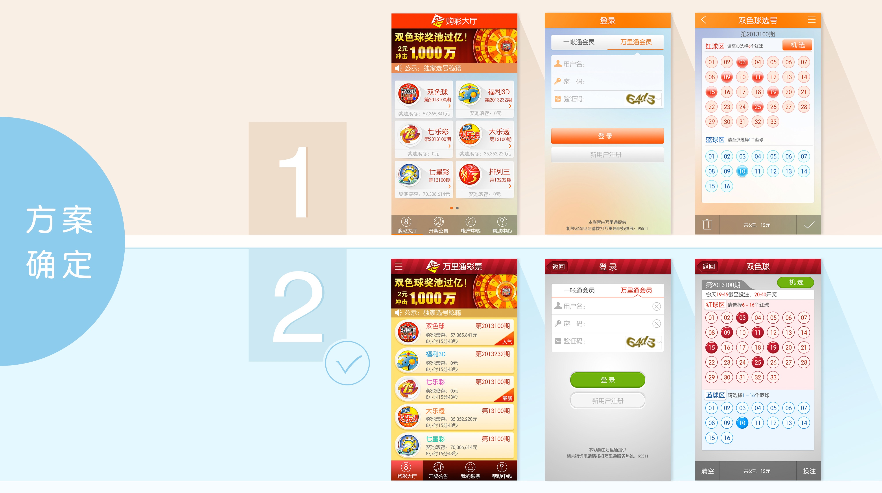

Slide 6


Slide 7


Slide 8


Slide 9
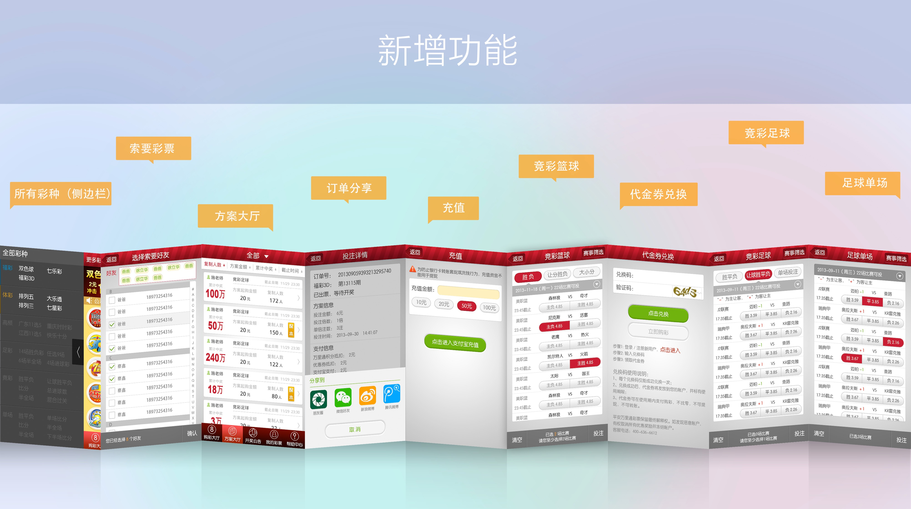

Slide 10
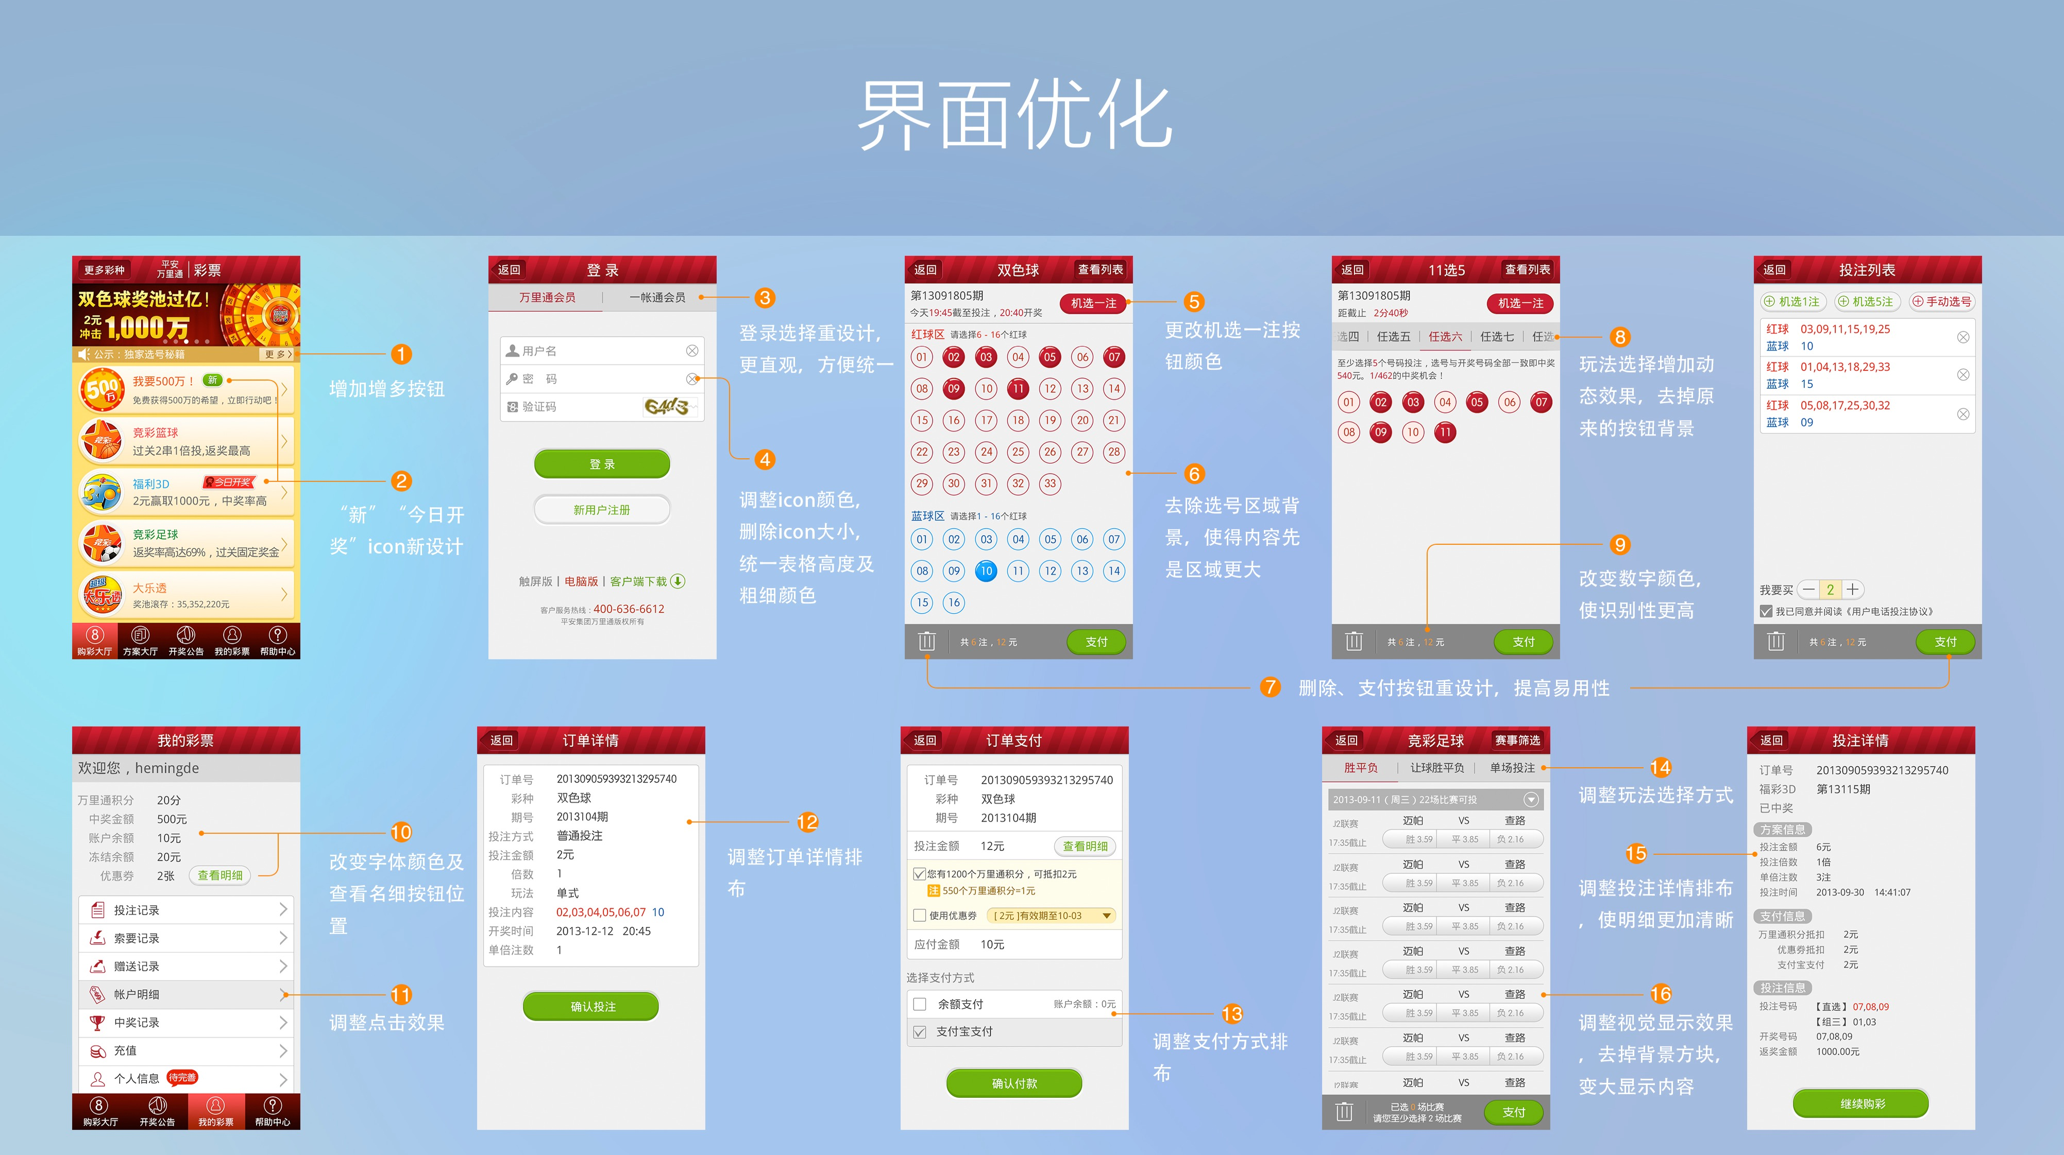

Slide 11


Slide 12


Slide 13

2013-12-25
Intuition doesn't help you find all the bugs in your product. Let real users test your product to see how they interact with it.

